Slide 1
Simulations for Studying Cognitive Reserve Friday Harbor Advanced Psychometric Methods in Cognitive Aging Workgroup 10
Maria Glymour
Department of Epidemiology and Biostatistics
University of California, San Francisco

Slide 2
Our group goals: Learn to use simulations
A flexible, powerful tool to better:
understand statistical methods
improve communication with people in other disciplines
think clearly about your methods and whether they are answering the question you want to ask
conduct power/sample size calculations
Ask many questions you could not address with available data.
Simulations naturally link to modern causal inference methods so some of the thinking for DAGs, collider bias, and counterfactuals will be incorporated. Evaluating mediation also possible.
We’ll use Stata and R, drawing on simulation platform developed by ER Mayeda.

Slide 3
Our group goals
Answer some specific questions
If diagnosis of dementia is slightly delayed for high education individuals (because tests don’t work as well), could that account for observed cognitive reserve patterns?
If we think about preventing “dementia”, which has the biggest likely benefit: improving cognitive reserve or reducing/slowing rate of decline?
Other questions:
Role of measurement error, practice effects, and unmeasured confounding in observed results for cognitive reserve. We can simulate anything the other groups are exploring to see what analyses would “work”.
Simulations for Studying Cognitive Reserve
Simulations for Studying Cognitive Reserve

Slide 4
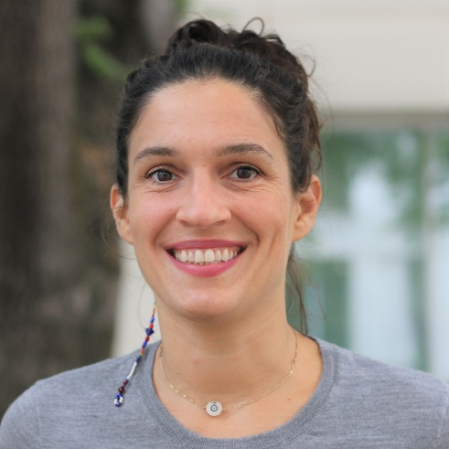
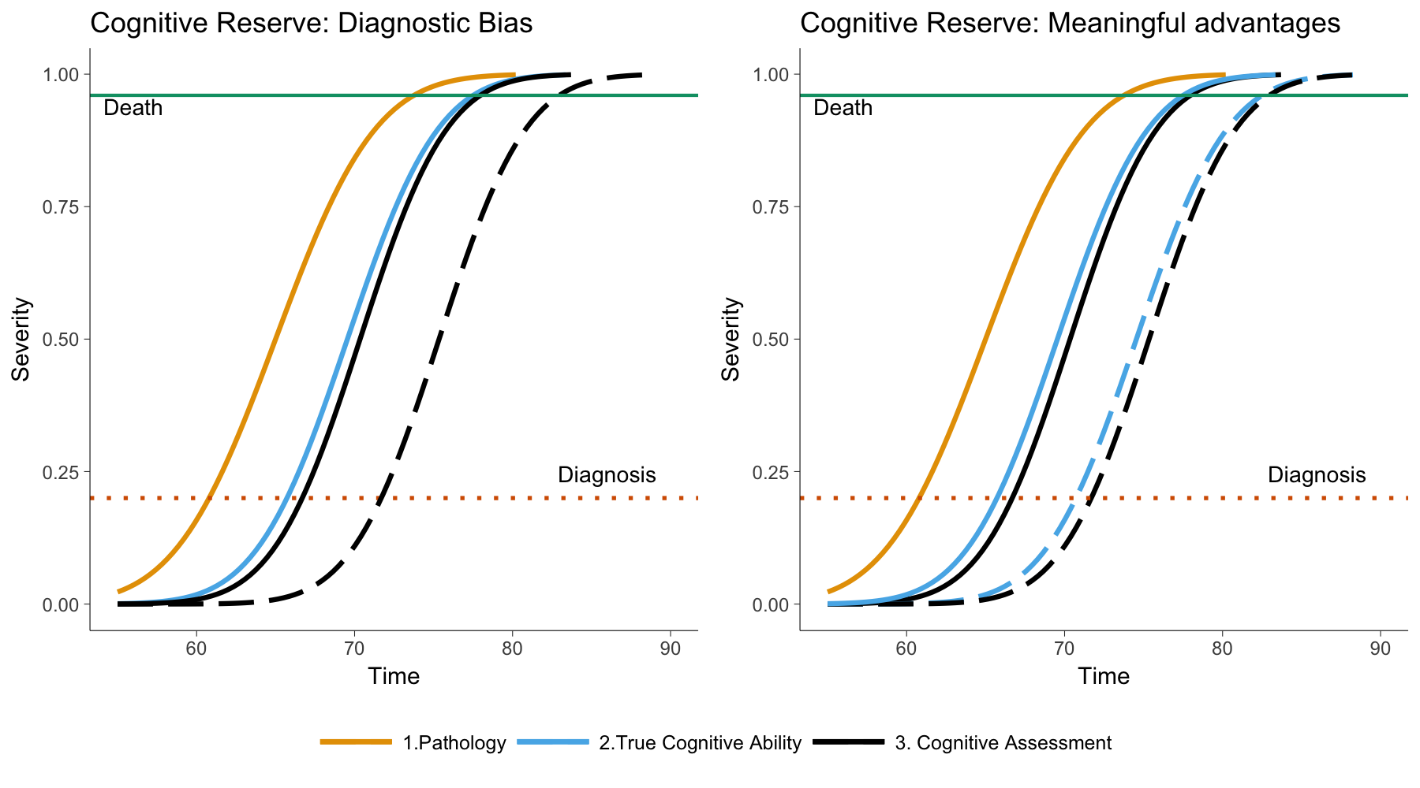
Can CR be explained by diagnostic bias?
Filshtein et al., in prep
CR delays dementia diagnosis, but possibly because of discrepancies between “true” cognition and test scores.
How much of a delay would be necessary to account for empirical patterns to date?

Slide 5
Advantages of Simulation Group
Extremely public health relevant.
If your brain hurts thinking about cognitive reserve estimation methods, writing out the simulations will help.
Very flexible tool you will likely use in other settings

Slide 6
Advantages of Simulation Group
Extremely public health relevant.
If your brain hurts thinking about cognitive reserve estimation methods, writing out the simulations will help.
Very flexible tool you will likely use in other settings
Data Use Agreements are very flexible – you can take the data home with you!

Slide 7
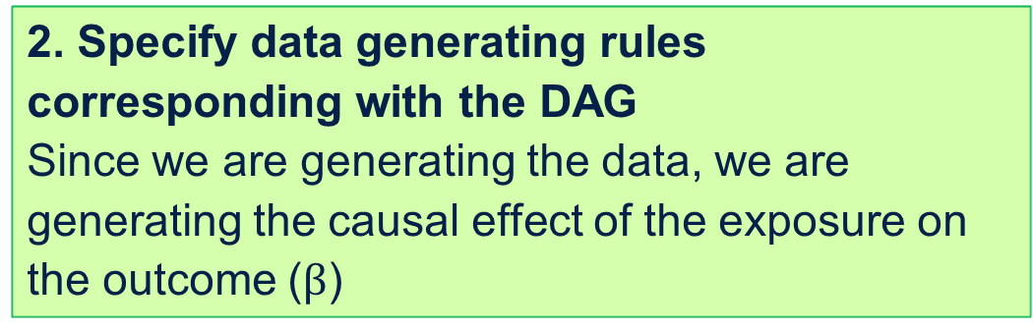
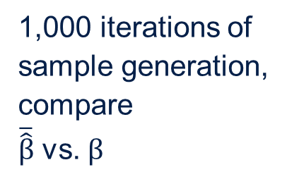
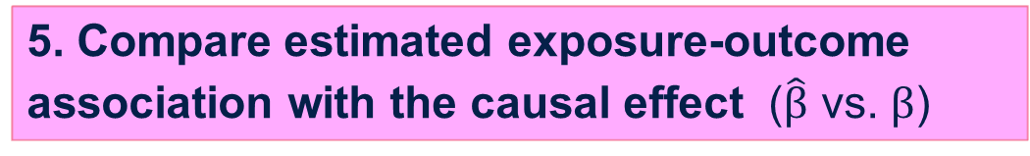
1. Express causal structure as a DAG
2. Specify data generating rules corresponding with the DAG
Since we are generating the data, we are generating the causal effect of the exposure on the outcome ($β$)
Repeat!
Varying causal structure and parameterizations
3. Generate data according to specified rules
1,000 iterations of sample generation,
compare
$\overline{\hat{β}}$ vs. $β$
4. Estimate exposure-outcome association ($\hat{β}$)
5. Compare estimated exposure-outcome association with the causal effect ($\hat{β}$ vs. $β$)
From ER Mayeda
Notes:
These steps are for one causal structure and one set of parameterizations. ..Different causal structures or different parameterizations, so often it’s useful to look across multiple scenarios

Slide 8
Outline
Learning objectives:
Understand the concept of power calculations
Learn to construct the elements of a power calculation using a simulation
Steps for conducting a simulation study for a power calculation
Some basic intro points (for later)

Slide 9
Power!!!
The framework for power calculations draw on null hypothesis significance testing (NHST) which is increasingly frowned upon.
Nonetheless, power and sample size calculations (flip sides of the same coin) are essential tools.
We’ll review the basics for power calculations
There are a gazillion online power calculators and thousands of specialized apps or things built into your favorite statistical package.
I find that often, none of these options quite addresses the statistical situation I face (for reasons we will discuss).
In this case power calcs from simulations are a handy-go-to tool.
These also illustrate the power of simulations so make a nice jumping off point.

Slide 10
Calculate power, sample size, minimum detectable effect size?
Statistical power is the probability that, if an effect size is as large as you hypothesize (H_{a}), and you apply a specific alpha criterion (e.g., p<.05) to test the null hypothesis (H₀) in a data set of size N with a particular exposure distribution (e.g., 50% exposed, 50% unexposed), you would reject the null hypothesis.
Sample size (N) calculations estimate the sample size N you would need to achieve a target level of statistical power (e.g., 80%), assuming a particular exposure distribution and effect size is as large as you hypothesize and that you apply a specific alpha criterion to test the null hypothesis.
Minimum detectable effect size is the smallest effect size you would have a specific amount of statistical power to detect in a data set of size N with a particular exposure distribution and using a specific alpha criterion to test the null hypothesis.
There are 4 components; specifying 3 determines the fourth.
Effect size is often expressed as two input assumptions, e.g., the difference in means and the variance of the outcome, but focus on the Z-score effect.

Slide 11
Calculate power, sample size, minimum detectable effect size?
If you are conducting secondary data analysis, there’s not much use in a sample size calculation; that is already fixed.
With secondary data, estimate power (if you have a reasonable estimate of the anticipated effect size) or MDE (if you have no idea of the anticipated effect size)

Slide 12
Statistical Hypothesis Testing
Decision | H_{o} is true i.e., there is really no effect to find | H_{o} is false i.e., there really is an effect to be found
Reject H_{o} | Type I error: prob = α | correct decision: prob = 1 - β
“Fail to reject” H_{o} | correct decision: prob = 1 - α | Type II error: prob = β
Slide modified from: Mike Cox, Newcastle University,, https://www.staff.ncl.ac.uk/mike.cox/III/power.ppt

Slide 13
Example
H₀= low education individuals have the same average BMI as high education individuals
H_{a}= low education individuals have a BMI 1 standard deviation higher than high education individuals
Test with a sample of N=2,000
50% of the sample has high education and 50% low education individuals
Use α=.05 (two-sided test)

Slide 14
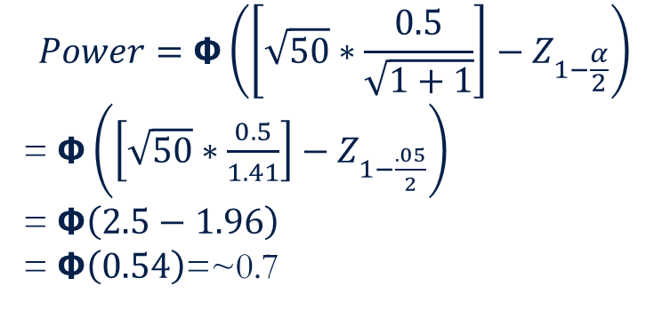
Example
H₀= low education individuals have the same average BMI as high education individuals
H_{a}= low education individuals have a BMI 0.5 standard deviation higher than high education individuals
Test with a sample of n₁=n₂=50; N=100
50% of the sample has high education and 50% low education individuals
Use α=.05 (two-sided test)
Stata:
power twomeans 0 0.5, n(100) a(.05) sd(1)
power twomeans 0 0.5 , n(100)
$$Power=Φ\left(\left[\sqrt{50}∗\frac{0.5}{\sqrt{1+1}}\right]−Z_{1−\frac{α}{2}}\right)$$
= $Φ\left(\left[\sqrt{50}∗\frac{0.5}{1.41}\right]−Z_{1−\frac{.05}{2}}\right)$
= $Φ\left(2.5−1.96\right)$
= $Φ\left(0.54\right)$=~0.7

Slide 15
Why simulate?
There is a closed form solution for the power with a comparison of two means, i.e., we can write out the formula and solve it with a few assumptions.
Often, you want to do something for which there is no such simple power calculation, e.g., compare the 78th percentile of a distribution, or estimate an IV model based on a 38 SNP genetic risk score.
We will use a simulation for the simple problem so you can see how it works and compare it to the closed form solution.

Slide 16
Steps for conducting a simulation study using structural equation models
Next slides from Dr. ER Mayeda (all slides with good formatting…)

Slide 17
1. Express causal structure as a DAG
2. Specify data generating rules corresponding with the DAG
Since we are generating the data, we are generating the causal effect of the exposure on the outcome ($β$)
Repeat!
Varying causal structure and parameterizations
3. Generate data according to specified rules
1,000 iterations of sample generation,
compare
$\overline{\hat{β}}$ vs. $β$
4. Estimate exposure-outcome association ($\hat{β}$)
5. Compare estimated exposure-outcome association with the causal effect ($\hat{β}$ vs. $β$)
Notes:
These steps are for one causal structure and one set of parameterizations. ..Different causal structures or different parameterizations, so often it’s useful to look across multiple scenarios

Slide 18
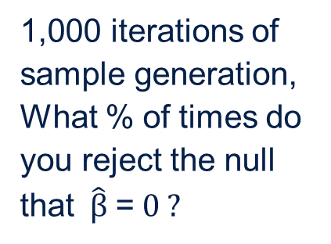
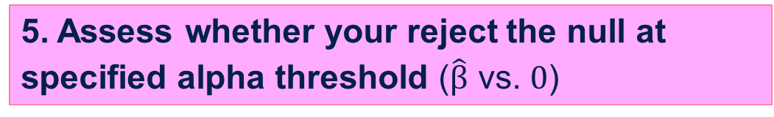
1. Express causal structure as a DAG
2. Specify data generating rules corresponding with the DAG
Since we are generating the data, we are generating the causal effect of the exposure on the outcome ($β$)
3. Generate data according to specified rules
1,000 iterations of sample generation,
What % of times do you reject the null that$\hat{β}$ = $0 ?$
4. Estimate exposure-outcome association ($\hat{β}$)
5. Assess whether your reject the null at specified alpha threshold ($\hat{β}$ vs. $0$)
Notes:
These steps are for one causal structure and one set of parameterizations. ..Different causal structures or different parameterizations, so often it’s useful to look across multiple scenarios

Slide 19
1. Express causal structure as a DAG
Low Education
BMI

Slide 20
2. Specify data generating rules corresponding with the DAG
LowEd~ Bernoulli(P(low education))
Dichotomous variable, where P(low education) = 0.50
If LowEd=0, then BMI ~ N(0,1)
For simplicity, we’ll say that BMI has been standardized. Actual mean BMI in adult Americans is close to 25, and standard deviation is ~5.
If LowEd=1 then BMI~N(0.5,1)
Low Education
BMI
Notes:
Useful resource on random-number generators in Stata: https://blog.stata.com/2012/07/18/using-statas-random-number-generators-part-1/

Slide 21
3. Generate data according to specified rules
Set random seed so you can reproduce findings later: set seed 97070
Generate a data set with n=1000 observations
Stata: set obs 1000
Apply the data-generating rules sequentially generate each variable, starting with the exogenous variables (no arrows in) and then for each of their descendant variables, as a function of its parents
Stata: gen LowEd=runiform()>.5
Stata: gen BMI=rnormal(0,1) if LowEd==0
replace BMI=rnormal(0.5,1) if LowEd==1
Stata alternative: gen BMI_e=rnormal()
gen BMI=BMI_e+0.5*(LowEd==1)
The alternative makes it easier to model counterfactuals. Useful later.
Notes:
Generate cancer for each person i in the simulated sample by generating a random number from a uniform distribution (U1_{i}~U[0,1)) and assign person i to Cancer=1 if Cancer)_{i} > U1_{i}; otherwise Cancer=0

Slide 22
3. Generate data according to specified rules
Generate a data set with n=100 observations
Apply the data-generating rules sequentially generate each variable, starting with the exogenous variables (no arrows in) and then for each of their descendant variables, as a function of its parents
id | LowEd | BMI_e | Actual BMI | Potential BMI_0 | Potential BMI_1
1 | 0 | -1.28 | -1.28 | -1.28 | -1.78
2 | 1 | -0.25 | 0.25 | -0.25 | 0.25
3 | 1 | 0.47 | 0.97 | 0.47 | 0.97
4 | 0 | 0.04 | 0.04 | 0.04 | 0.54
…
100 | 1 | 1.31 | 1.81 | 1.31 | 1.81
Notes:
Generate cancer for each person i in the simulated sample by generating a random number from a uniform distribution (U1_{i}~U[0,1)) and assign person i to Cancer=1 if Cancer)_{i} > U1_{i}; otherwise Cancer=0

Slide 23
4. Estimate exposure-outcome association ($\hat{β}$)
Estimate effect of Low Education on BMI
reg BMI LowEd

Slide 24
1. Express causal structure as a DAG
2. Specify data generating rules corresponding with the DAG
Since we are generating the data, we are generating the causal effect of the exposure on the outcome ($β$)
3. Generate data according to specified rules
1,000 iterations of sample generation,
What % of times do you reject the null that$\hat{β}$ = $0 ?$
4. Estimate exposure-outcome association ($\hat{β}$)
5. Assess whether your reject the null at specified alpha threshold ($\hat{β}$ vs. $0$)
Notes:
These steps are for one causal structure and one set of parameterizations. ..Different causal structures or different parameterizations, so often it’s useful to look across multiple scenarios

Slide 25
Repeat
clear
set seed 97070
set obs 1000
gen LowEd=runiform()>.5
gen BMI_e=rnormal()
gen BMI=BMI_e+0.5*(LowEd==1)
reg BMI LowEd

Slide 26
Repeat with a new random seed
clear
set seed 97070
set seed 2342
set obs 1000
gen LowEd=runiform()>.5
gen BMI_e=rnormal()
gen BMI=BMI_e+0.5*(LowEd==1)
reg BMI LowEd

Slide 27
Repeat 998 more times, recording estimate each time
set seed ####
Do SimPower1.do
clear
set obs 1000
gen LowEd=runiform()>.5
gen BMI_e=rnormal()
gen BMI=BMI_e+0.5*(LowEd==1)
reg BMI LowEd
Do SimPower1.do ….

Slide 28
Repeat 998 more times, recording estimate each time
set seed ####
simulate _b _se , reps(1000): do SimPower1
clear
set obs 1000
gen LowEd=runiform()>.5
gen BMI_e=rnormal()
gen BMI=BMI_e+0.5*(LowEd==1)
reg BMI LowEd
simulate _b _se z=_b[LowEd]/_se[LowEd] , reps(10): do SimPower1
gen p=normal(_eq2_z)

Slide 29
On your own
How would the power differ if you used a continuous version of education instead of a binary version?

Slide 30
Simulating in Stata: More sophisticated versions
Create two Stata do-files:
Data generation and analysis file: generates one data set, analyzes the generated data, and stores the parameter estimates from analyses as scalars (what we just did)
Run simulation file: calls the data generation and analysis file to generate and analyze B iterations of sample generation under the causal scenario, stores the results from each sample, summarizes the results across the B samples, and stores the summarized results

Slide 31
Run simulation file
The simulate command performs Monte Carlo-type simulations
Basic form of the code is:
simulate [list of scalars stored from each replication], reps(B) seed(#): do [data generation and analysis do file]
This will replicate B data sets using the data generating code and perform the analyses in the do file. Then it will pull the results from each replication we stored as scalars so we can summarize results across all B repetitions.
"reps(B)" specifies the number of replications
"seed(#)" specifies the random number seed
Simulate documentation: http://www.stata.com/manuals13/rsimulate.pdf
Notes:
Note that the first lines of code call in and assign the value from each scalar to a variable with the same name.

Slide 32
Data generation and analysis file
Create blank data set
Set parameters
Generate data
Look at associations and store results
Notes:
*log odds of cancer for ref group (nonobese and A=0) (lifetime risk)
local c0 = ln(0.10/(1-0.10))
*Parameters for odds of cancer
local c1 = ln(1.2) //effect of overwt on log odds of cancer in A=0 stratum
local c2 = ln(1.5) //effect of obesity on log odds of cancer in A=0 stratum
local c3 = ln(1.5) //effect of A on log odds of cancer in normal weight grp (OR=2.0)
local c4 = ln(1.0) //effect of A on log odds of cancer in overwt grp (OR=1.0)
local c5 = ln(1.0) //effect of A on log odds of cancer in obese grp (OR=1.0)
*log odds of death for ref group (no cancer)
local d0 = ln(0.04/(1-0.04))
*Parameters for odds of death
local d1 = ln(1.1) //effect of overwt on log odds of death
local d2 = ln(1.3) //effect of obese on log odds of death
local d3 = ln(2.0) //effect of A on log odds of death
local d4 = ln(2.76) //effect of cancer on log odds of death (OR=3.0

Slide 33
Epi270 Simulation Extra

Slide 34
How do you generate variables from your DAG?
Every variable is generated as a function of its parents and a random “noise” component
gen education=int(rnormal(12,2))
gen BMI_e=rnormal(25,5)
gen BMI=BMI_e-0.5*education
Low Education
BMI

Slide 35
How do you generate variables from your DAG?
Every variable is generated as a function of its parents and a random “noise” component
gen education=int(rnormal(12,2))
gen BMI_e=rnormal(25,5)
gen BMI=BMI_e-2*(education>12)
Low Education
BMI

Slide 36
How do you generate variables from your DAG?
Every variable is generated as a function of its parents and a random “noise” component
gen education=int(rnormal(12,2))
gen BMI_e=rnormal(25,5)
gen BMI=BMI_e-2*(education>12) if BMI_e>20
replace BMI=BMI_e+education>12) if BMI_e<=20
Low Education
BMI

Slide 37
How do you generate variables from your DAG?
Every variable is generated as a function of its parents and a random “noise” component
gen C=rnormal(0,1)
gen education=int(rnormal(12,2)+C*2)
gen BMI_e=rnormal(25,5)
gen BMI=BMI_e-education+C
C
Low Education
BMI

Slide 38
How do you generate variables from your DAG?
Every variable is generated as a function of its parents and a random “noise” component
gen C=rnormal(0,1)
gen A=rnormal(0,1)+C
gen BMI_e=rnormal(0,1)
gen BMI=BMI_e+A+C
Watch out for the exploding variance problem
C
A
BMI

Slide 39
How do you generate variables from your DAG?
Every variable is generated as a function of its parents and a random “noise” component
gen C=rnormal(0,1)
gen A=rnormal(0,.7)+C*.7
*Var A + B= Var(A)+Var(B)+2*Cov(A,B)
gen BMI_e=rnormal(0,1)
gen BMI=BMI_e*.57+A*.57+C*.57
C
A
BMI

Slide 40
Some useful distributions
set obs 10000
gen showmeuniform=runiform()

Slide 41
Some useful distributions
gen showmenormal=rnormal()

Slide 42
Some useful distributions
gen showmelognormal=exp(rnormal())
gen showmeloglognormal=log(showmelognormal)

Slide 43
Some useful distributions
gen showmebinomial1=runiform()>.3

Slide 44
Some useful distributions
gen showmebinomial=rbinomial(1,.3)

Slide 45
Some useful distributions
gen showmebinomial100=rbinomial(100,.3)

Slide 46
Some useful distributions
gen showmeexponential=rexponential(10)
Equal probability of failure (1/10) at each time interval, average=10.

Slide 47
Some useful distributions
Low Education
failtime
gen lowedn=runiform()<.5
gen failtime=rexponential(10-5*lowedn)
Avg failtime=10 for high education, 5 for low education
Avg fail rate=1/10 for high education, 1/5 for low education

Slide 48
Some useful distributions
Low Education
failtime
gen lowedn=runiform()<.5
gen failtime=rexponential(10-5*lowedn)
stset failtime
stcox lowedn

Slide 49
Introduce censoring
Low Education
failtime
gen fail=1 if failtime<10
replace fail=0 if failtime>=10
replace failtime=10 if fail==0
stset failtime, fail(fail)
stcox lowedn
Censored

Slide 50
Homework
Consider 3 data generating scenarios that you expect to introduce collider bias.
Draw the DAG for each
Write out the data generating rules
Write the simulation to generate data with n=500
Estimate the collider bias

Slide 51
End of class slides: remainder from ER Mayeda

Slide 52
Data generation and analysis file
Start by creating a blank data set
set obs #### //creates blank dataset with #### observations
Next, set parameters using local macro variables
local x 1 //creates a local macro called x and gives it a values of 1
To call the local macro, you write its name surrounded by a specific set of quotation marks: `x’
A local macro is a temporarily defined macro that only exists within the do-file in which it is defined
Notes:
Stata documentation on macros: “A macro is a string of characters, called the macroname, that stands for another string of characters, called the macro contents.” http://www.stata.com/manuals13/u18.pdf#u18.3Macros
Stata documentation on local macros: “Local macros exist solely within the program or do-file in which they are defined. If that program or do-file calls another program or do-file, the local macros previously defined temporarily cease to exist, and their existence is reestablished when the calling program regains control. When a program or do-file ends, its local macros are permanently deleted.”
http://www.stata.com/manuals13/pmacro.pdf

Slide 53
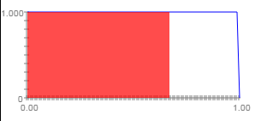
Data generation and analysis file
Generating continuous variables:
*Generate A, where A~N(0,1)
gen A = rnormal()
Generating binary variables:
*Specify prevalence of C
local PC = 0.67
*Generate C
gen C = runiform()<`PC'
runiform() produces random
numbers over [0,1)
0.67
Documentation on Stata’s random number generators: http://blog.stata.com/2012/07/18/using-statas-random-number-generators-part-1/

Slide 54
Run simulation file
Call the data generation and analysis file B times to generate and analyze B data sets and store the results from each replication as scalars
Summarize results across the B replications
Stores the results from the B replications (one replication = one row in the file)

Slide 55
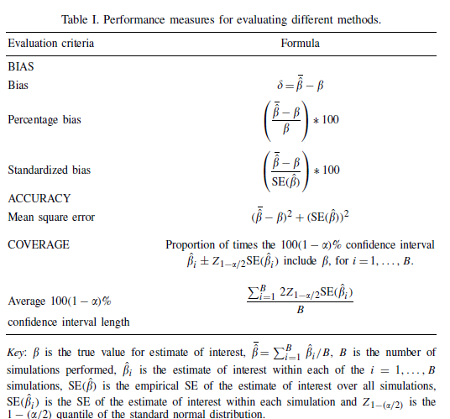
Evaluating simulation results
Burton, A., Altman, D. G., Royston, P., & Holder, R. L. (2006). The design of simulation studies in medical statistics. Statistics in medicine, 25(24), 4279-4292.

Slide 56
Simulation exercise: Data Generating Models to Illustrate the Meaning of Interaction

Slide 57
Exercise 1

Slide 58
Exercise
Dense breasts and obesity are each risk factors for breast cancer
You are interested in whether the effect of breast density on breast cancer risk is different for women who are obese versus non-obese
Exposure 1: Breast density defined as % of the breast is dense based on each woman’s first mammogram in the registry
Exposure 2: Obesity defined as BMI ≥30 vs. < 30 at the time of each woman’s first mammogram in the registry
We will conduct a hypothetical cohort study of 10,000 women in based on a registry of all women in California who had a mammogram between 1996 and 2005 followed for ten years for incident breast cancer
Outcome: Breast cancer diagnosis within 10 years of first mammogram in the registry

Slide 59
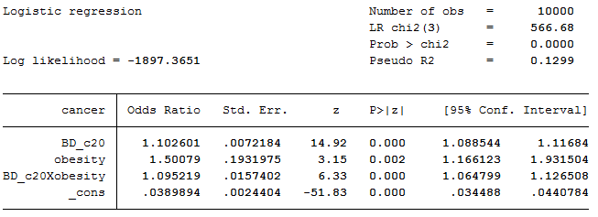
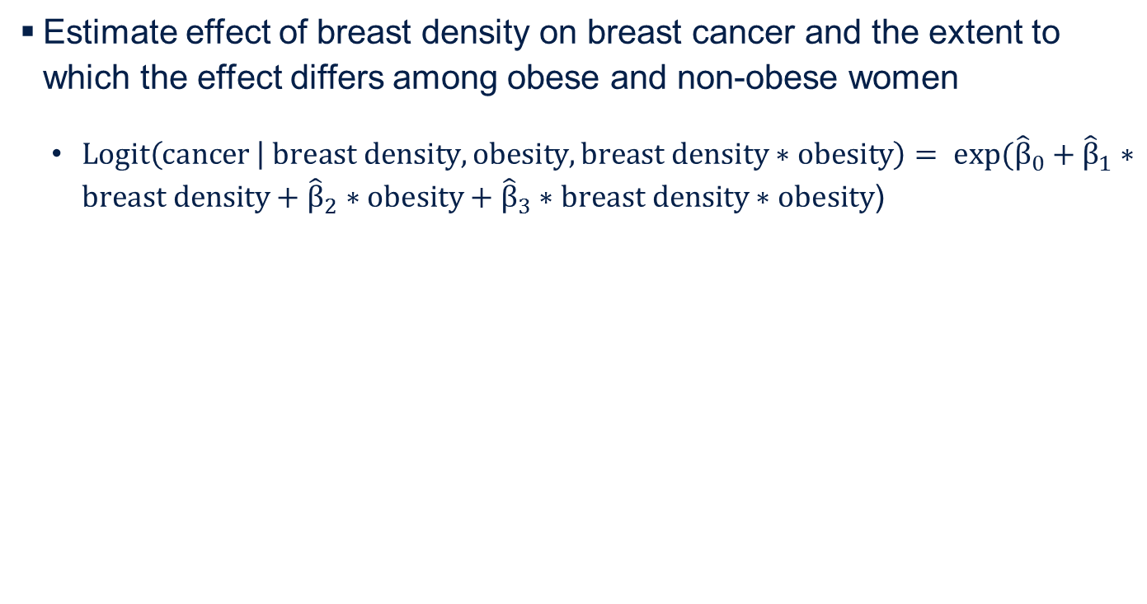
4. Estimate exposure-outcome association ($\hat{β}$)
Estimate effect of breast density on breast cancer and the extent to which the effect differs among obese and non-obese women
$Logit\left(cancer | breast density, obesity, breast density∗obesity\right)= exp({\hat{β}}_{0}+{\hat{β}}_{1}∗breast density+{\hat{β}}_{2}∗obesity+{\hat{β}}_{3}∗breast density∗obesity$)

Slide 60
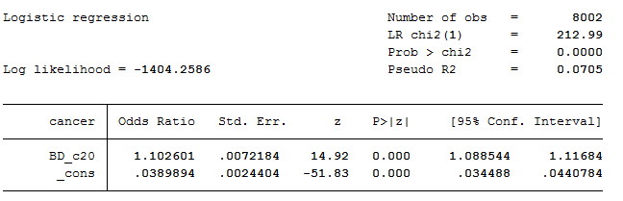
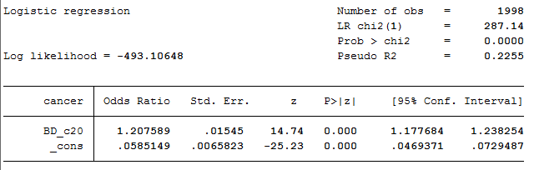
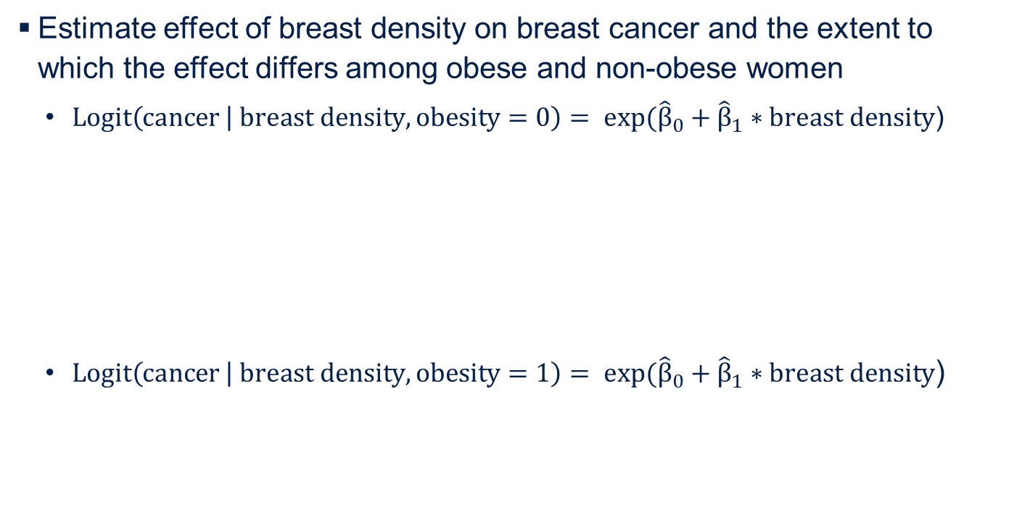
4. Estimate exposure-outcome association ($\hat{β}$)
Estimate effect of breast density on breast cancer and the extent to which the effect differs among obese and non-obese women
$Logit\left(cancer | breast density, obesity=0\right)= exp({\hat{β}}_{0}+{\hat{β}}_{1}∗breast density$)
$Logit\left(cancer | breast density, obesity=1\right)= exp({\hat{β}}_{0}+{\hat{β}}_{1}∗breast density$)

Slide 62
Exercise 2

Slide 63
Gender and crime victimization modify neighborhood effects on adolescent mental health
Osypuk, et al. Pediatrics (2012)
OBJECTIVE: Leverage an experimental study to determine whether gender or recent crime victimization modify the mental health effects of moving to low-poverty neighborhoods.
METHODS: The Moving to Opportunity (MTO) study randomized low-income families in public housing to an intervention arm receiving vouchers to subsidize rental housing in lower-poverty neighborhoods or to controls receiving no voucher. We examined 3 outcomes 4 to 7 years after randomization, among youth aged 5 to 16 years at baseline (n = 2829): lifetime major depressive disorder (MDD), psychological distress (K6), and Behavior Problems Index (BPI). Treatment effect modification by gender and family’s baseline report of recent violent crime victimization was tested via interactions in covariate-adjusted intent-to-treat and instrumental variable adherence-adjusted regression models.
RESULTS: Gender and crime victimization significantly modified treatment effects on distress and BPI (P < .10). Female adolescents in families without crime victimization benefited from MTO treatment, for all outcomes (Distress B = –0.19, P = .008; BPI B = –0.13, P= .06; MDD B = –0.036, P = .03). Male adolescents in intervention families experiencing crime victimization had worse distress (B = 0.24, P = .004), more behavior problems (B = 0.30, P < .001), and nonsignificantly higher MDD (B = 0.022, P = .16) versus controls. Other subgroups experienced no effect of MTO treatment. Instrumental variable estimates were similar but larger.
CONCLUSIONS: Girls from families experiencing recent violent crime victimization were significantly less likely to achieve mental health benefits, and boys were harmed, by MTO, suggesting need for cross-sectoral program supports to offset multiple stressors.

Slide 64
1. Express causal structure as a DAG
2. Specify data generating rules corresponding with the DAG
Since we are generating the data, we are generating the causal effect of the exposure on the outcome ($β$)
Repeat!
Varying causal structure and parameterizations
3. Generate data according to specified rules
1,000 iterations of sample generation,
compare
$\overline{\hat{β}}$ vs. $β$
4. Estimate exposure-outcome association ($\hat{β}$)
5. Compare estimated exposure-outcome association with the causal effect ($\hat{β}$ vs. $β$)
Notes:
These steps are for one causal structure and one set of parameterizations. ..Different causal structures or different parameterizations, so often it’s useful to look across multiple scenarios

Slide 66
Examples of using simulations in my reserach
Simulation platform for quantifying potential survival bias in longitudinal studies of cognitive aging. Mayeda et al., American Journal of Epidemiology 2016
Collider-stratification bias and heterogeneity in disease bias potential explanations for the obesity paradox in cancer. Mayeda and Glymour, Cancer Epidemiology, Biomarkers & Prevention 2017
Can selection bias explain the age attenuation of racial disparities in stroke incidence? Mayeda et al., under review
Does selective survival prior to study enrollment attenuate estimated effects of education on rate of cognitive decline in older adults? Mayeda et al., under review
What are examples from your research where you could use simulations?
Notes:
Quantifying bias arising from measurement error, confounding, collider-stratification bias, etc.
Quantitative sensitivity analyses
Power analysis
Evaluating statistical model performance—comparing alternative analytic models

